Slide 1
Children’s of Alabama
PHYSICIAN’S GUIDE
to Micromedex
360 Care Insights
Use Page Down to advance through Guide

Slide 2
What is 360 Care Insights (CI)?
Formerly known as MData & Clinical Xpert
360 CI provides view only access to real time patient information collected from Children’s of Alabama (CoA) hospital systems including lab, radiology & pharmacy
Information is presented in a consolidated web-based view via a desktop computer or a mobile device such as an iPhone

Slide 3
Icons for Access to 360 CI
Look for these icons
on Children’s computer Desktop
on iPhone
360 CI is accessible on & off campus via an iPhone with Internet access if the app is loaded and setup properly

Slide 4
Web Address for Access
Enter the following address in
Internet Explorer
(Chrome and other browsers may not function properly)
On Children’s Campus: mdataweb
Off Campus: mdataweb.chsys.org

Slide 5
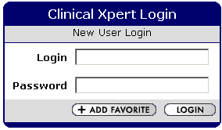
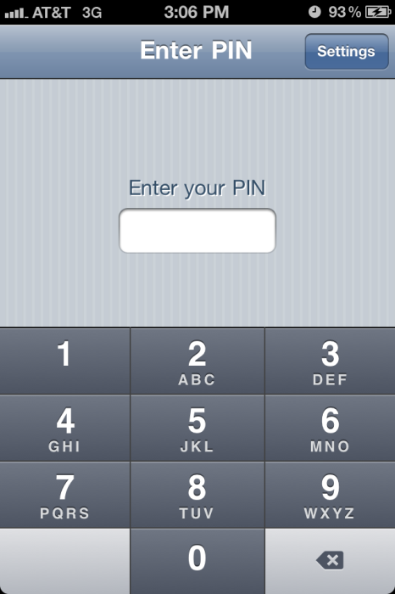
Login Screen
On Computer
Via Internet Explorer: - Your Login ID will be “phy” followed by your physician/resident number assigned by Medical Staff Services - MSS@ChildrensAL.org - Your initial password will be uppercase “WELCOME” and you will be required to change this before you are able to login
On iPhone
On an iPhone or mobile device: Your initial PIN will be “1111” and you will be required to change this before you are able to login

Slide 6
On Computer
Patient List
The Patient List will be the first screen that displays in 360 CI on Internet Explorer or a mobile device
On iPhone
<patient name>
<patient name>
<patient name>

Slide 7
Subscribe to Lists
Select the list(s) to which you would like to subscribe or unsubscribe
On Computer
Select the pencil & paper icon
Use a computer to access the web-based version of 360 CI to make List subscription changes as this functionality is not available on mobile devices

Slide 8
Viewing Patient List
- Select the List of patients to you would like to view
(ALL) shows all patients for all subscribed lists (will take longer to load)
On Computer
On iPhone

Slide 9
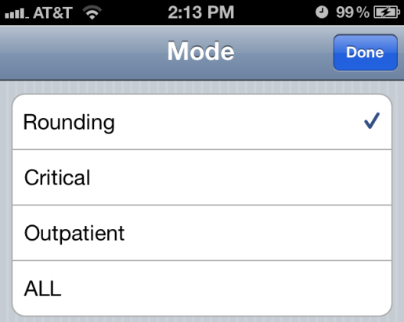
Patient List Modes
All - Displays all patients
Critical - Displays only patients with a critical lab value
Rounding - Displays all inpatients for the lists to which you are subscribed
Outpatient -Displays all outpatients
On Computer
On iPhone
*Always Sync to update Patient List after changing the Mode on a mobile device

Slide 10
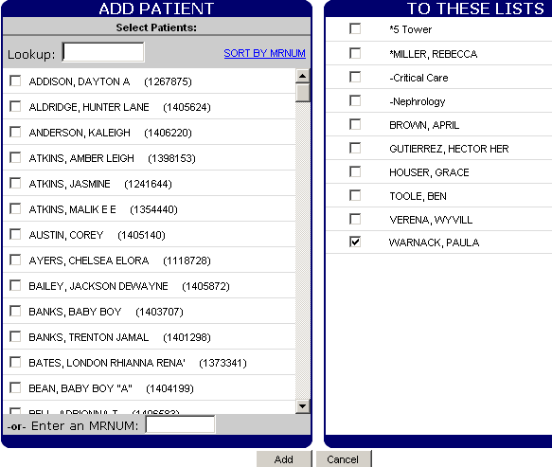
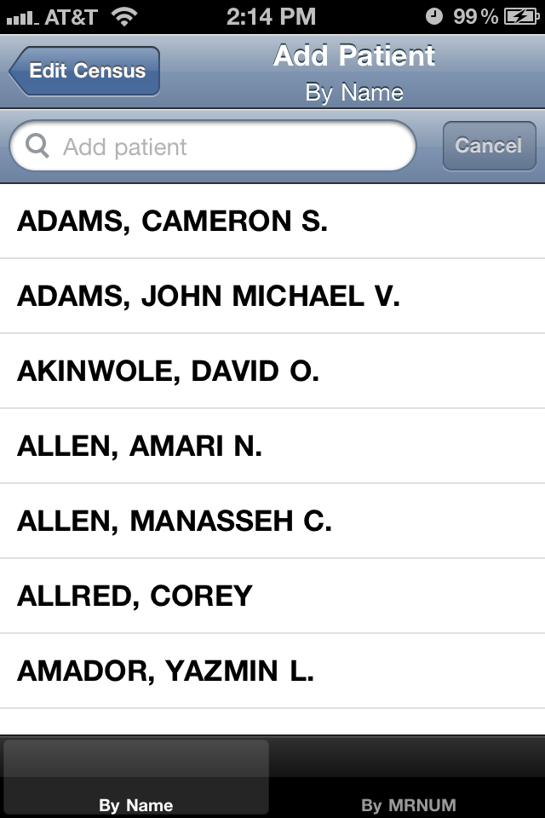
Adding Patients
On Computer
On iPhone
*Always Sync after adding any patients on a mobile device
To manually add a patient to a List, search for the patient by Name or 7 digit Medical Record Number (MRNUM) and then select the patient name & the List to which the patient should be added
Patients adds should only be temporary & all manually added patients must be manually deleted

Slide 11
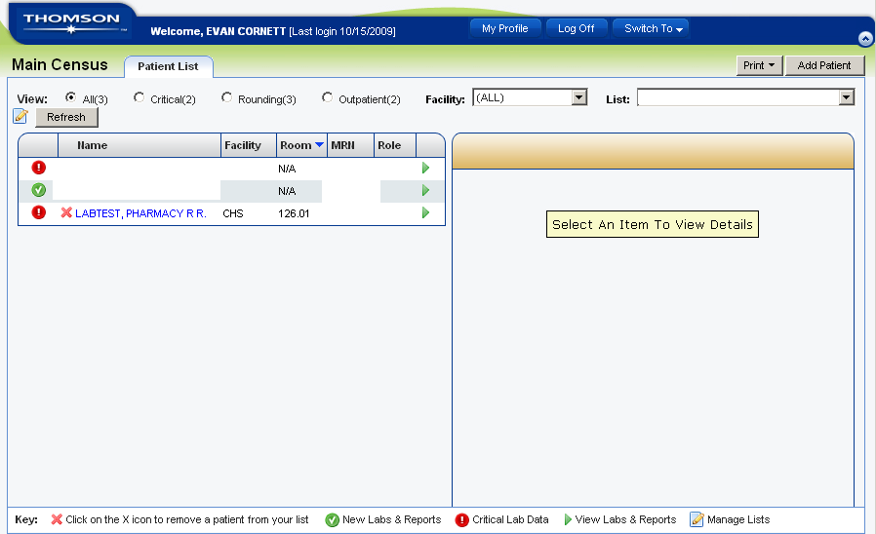
Deleting Patients
On Computer
The red X indicates that a patient was manually added to a list; click the X to remove the patient
Note: “N/A” in Room column indicates an outpatient or a manually-added inpatient who has been discharged
On iPhone
<patient name>
<patient name>
The symbol allows removal of a patient that was manually added to a list; select to Remove (or Hide if not manually added)

Slide 12
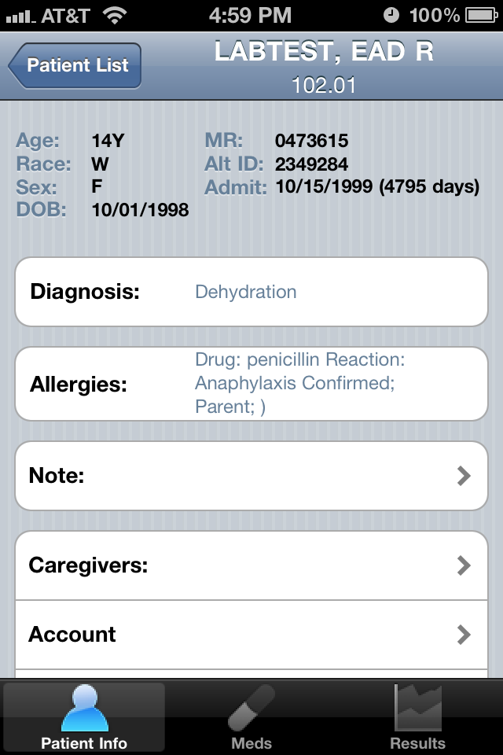
Patient Demographics
On Computer
On iPhone
Select a patient then the Patient Demographics/Info tab to view available information

Slide 13
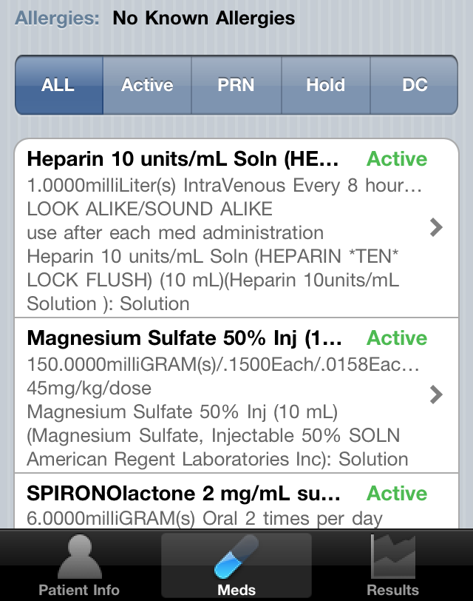
Patient Medications
On Computer
On iPhone
Select a patient then the Results/Meds tab
Select to filter by ALL, Active, PRN, Hold or Discontinued/DC
Note: Discontinued medications will show for 48 hours with red highlighting and D/C! beside the drug name

Slide 14
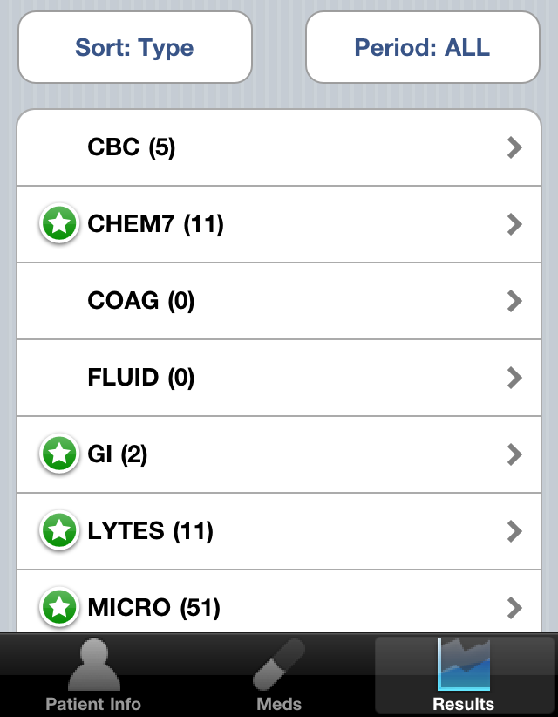
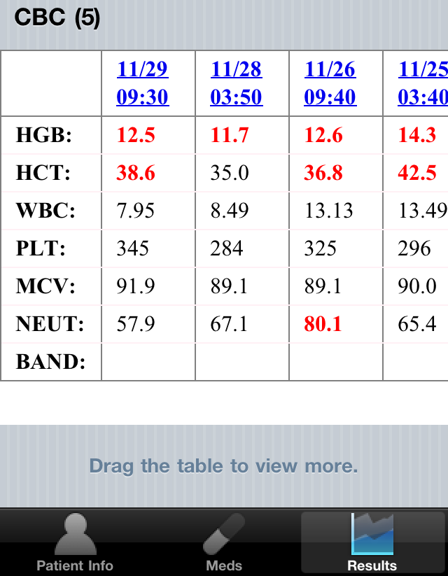
Patient Results
On Computer
Select a patient then the Results tab
Select to desired Results Type
(Number) indicates the number of results available
Values in red indicate a critical lab value
On iPhone

Slide 15
For questions or assistance contact
Children’s of Alabama
Customer Support
(24 hours a day)
Email: GetHelp@ChildrensAL.org
Phone: 205-638-6568
Thank you!

